Slide 1

Microcontroller Architecture and Programming
22EECF202/22EEIP213
Course Project –Module Development
Team: 16 Division: ‘B’
Name USN
Amit Kumar 01fe22bec045
Nidhi Neje 01fe22bec049
Sejal Ankush 01fe22bec051
Sakshi Kulkarni 01fe22bec058

Slide 2
Contents :
Problem Statement
Functional Block Diagram
Interfacing Diagram
Code with comments
Results Simulation
Results Hardware

Slide 3
Problem Statement
INTERFACING
OF
DIGITAL TO ANALOG CONVERTER

Slide 4
Functional Block Diagram Method 1-Output on CRO
8051 PROGRAMMER
8051 EVALUATION BOARD
Supply
INPUT : 0808 IC(DAC)
OP AMP
OUTPUT: CRO

Slide 5
Sine Wave Generation on CRO:
Generating Sinewave using DAC and 8051 Microcontroller For generating sinewave, at first we need a look-up table to represent the magnitude of the sine value of angles between 0° to 360°. The sine function varies from -1 to +1. In the table only integer values are applicable for DAC input. In this example we will consider 30° increments and calculate the values from degree to DAC input. We are assuming full-scale voltage of 10V for DAC output. We can follow this formula to get the voltage ranges. Vout = 5V + (5 ×sinθ)

Slide 6
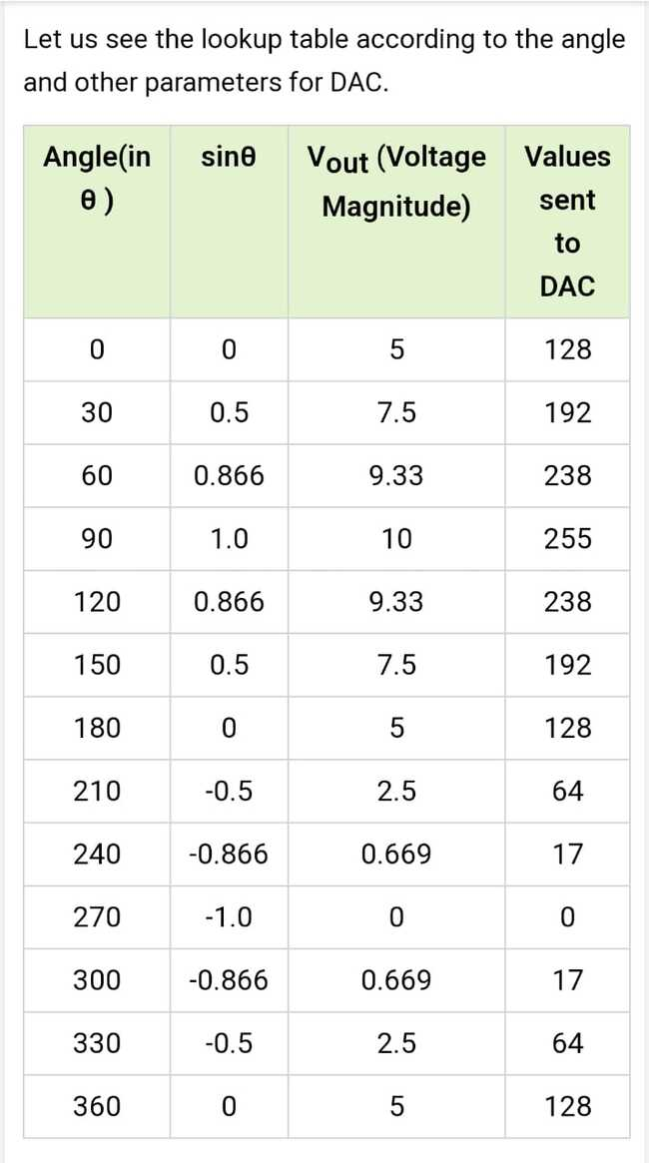

Slide 7
Code –Method 1
#include<reg51.h>
sfr DAC=0xA0; //Port P2 address
void main()
{int sin_value[12]=(128,192,238,255,238,192,128,64,17,0,17,64);
int i;
while (1)
{for (i=0; i<12; i++)
{DAC=sin_value[i];
}
}
}

Slide 8
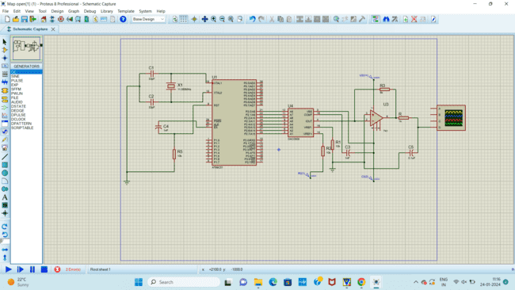
Simulation: Method 1

Slide 9
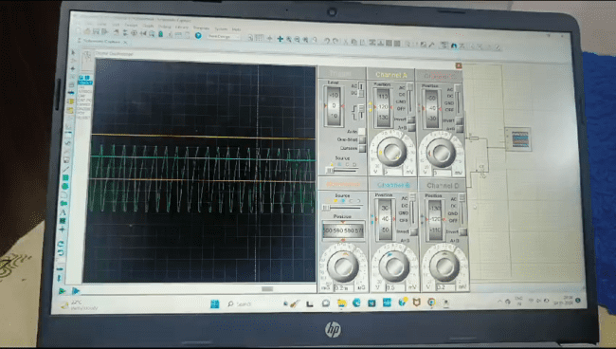
Software Implementation:

Slide 10
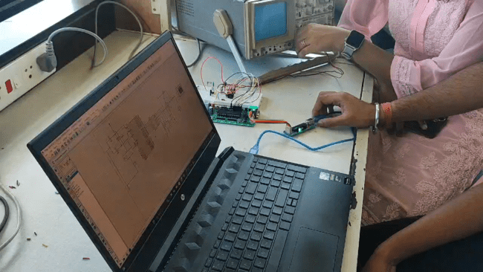
Results Hardware

Slide 11
METHOD 2-Output on Voltmeter
The 8051 microcontroller is interfaced with the DAC 0800 from P1.0 to P1.7 (P1.0 being LSB and P1.7 being MSB) to PINS A1 to A8 (A1 being MSB and A8 being LSB).
The biasing positive voltage reference of +5V and gnd to negative reference voltage.
This DAC gives output in form of current IO.
To get converted to voltage with gain an op-amp 741 is used.
The IO=Iref(D7/2+D6/4+D5/8+D4/16+D3/32+D2/64+D1/128+D0/256)
Where Iref=Vref/input impedance; Vout=IO*impedance.
The output is then observed on a voltmeter.

Slide 12
CODE-Method 2
#include<reg51.h>
unsigned int array1[8]={0x80,0xc0,0xe0,0xf0,0xf8,0xfc,0xfe,0xff};
void delay(unsigned int);
sbit l1=P1^0;
sbit l2=P1^1;
sbit l3=P1^2;
sbit l4=P1^3;
sbit l5=P1^4;
sbit l6=P1^5;
sbit l7=P1^6;
sbit l8=P1^7;

Slide 13
int main()
{
unsigned int i;
P1=0xff;
for(i=0;i<9;i++)
{ P1=array1[i];
delay(100000);
ACC=P1;
P3=ACC;
delay(500000);
}
}
void delay(unsigned int count)
{ unsigned int i;
for(i=0;i<=count; i++);}

Slide 14
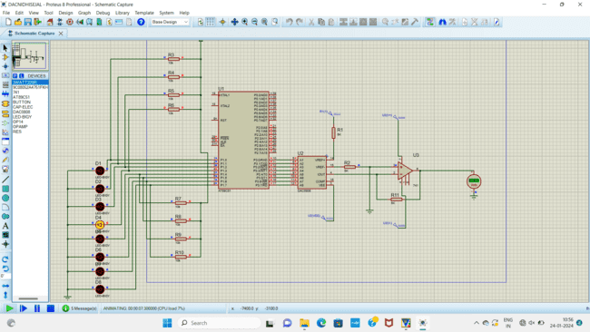
Simulation-Method 2

Slide 15
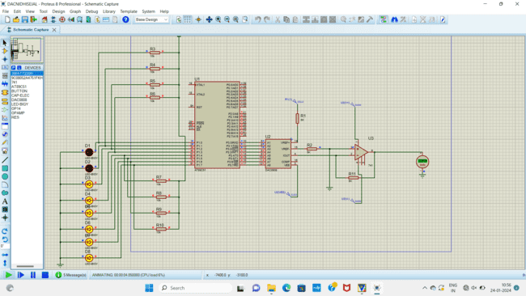

Slide 16
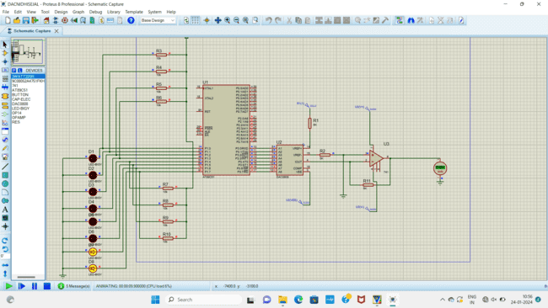

Slide 17
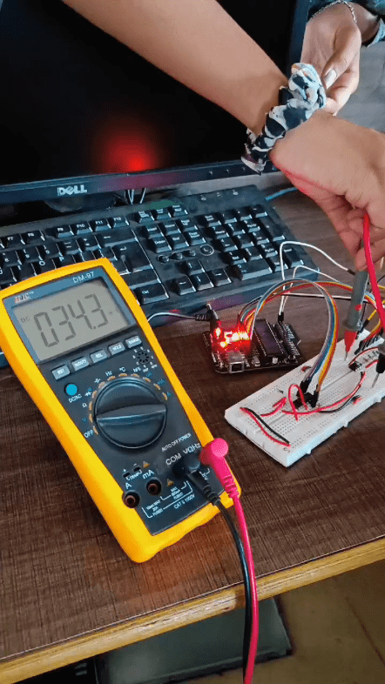
Results Hardware

Slide 18
Learning outcomes
-> Architecture and working of 8051 microcontroller.
-> Applications of 8051 microcontroller.
-> Techniques to convert digital signal to analog signal.
-> DAC interfacing with microcontroller.

Slide 19
Thank you

